Slide 1
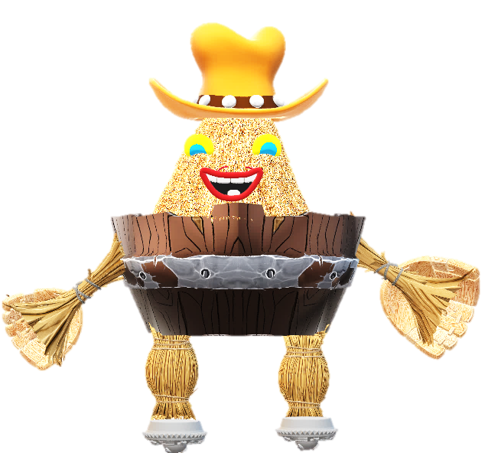
Agridon
User Manual
Author: Sajini Varadharajan
Notes:
Preworks course home assignments

Slide 2
Table of Contents
S.No | Slide Content | Slide No.
1 | Acknowledgements | 3
2 | It’s me, Sajini! | 4
3 | About My Internship Journey with Clevered… | 5
4 | Introduction to Agridon | 6
5 | Components of Agridon | 7-10
6 | Agridon’s features and contents | 11-14
7 | Contact Name | 15
8 | Thank you | 16

Slide 3
Acknowledgements
To the Almighty, who helped me accomplish this PIP project.
To my parents and grandparents for encouraging, motivating and standing by me always.
To my mentors (Ms. Shivani, Ms. Smita, Ms. Shiksha, Mr. Avishek, Mr. Prateek) for enriching me with their endless knowledge.
A special mention to Mr. Ken for being a guiding light.
Thank you to Ms. Samreen Rizvi for being a fantastic teacher.
To everyone who made this possible, thank you from the bottom of my heart.

Slide 4
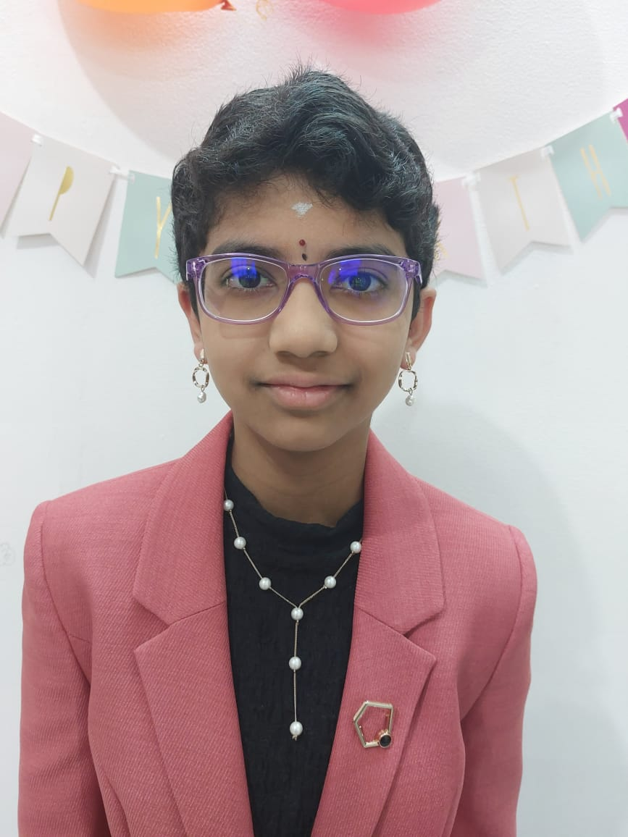
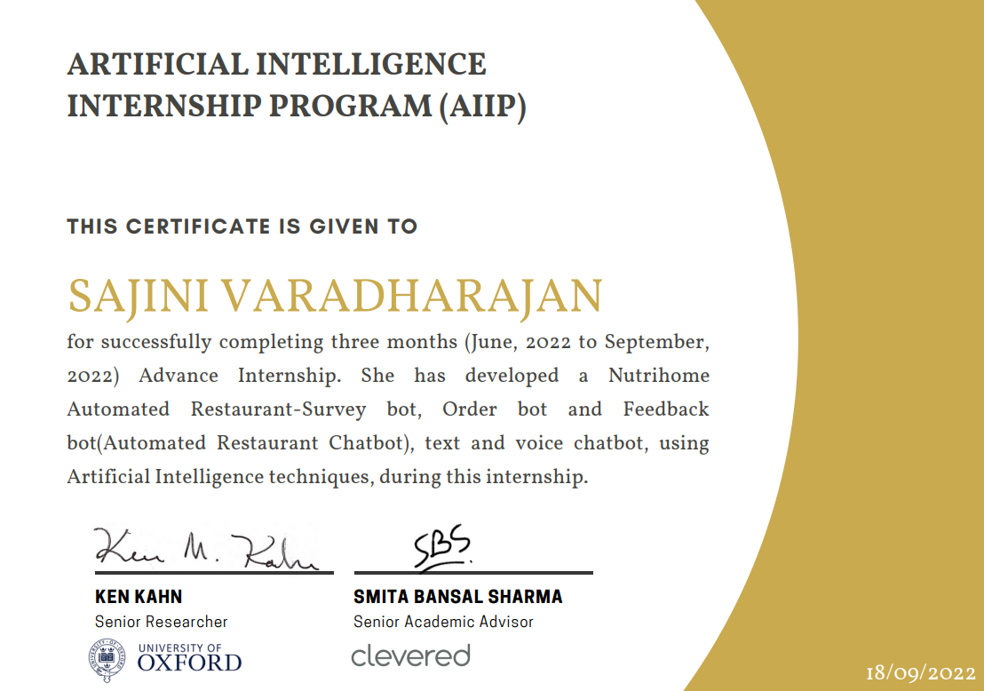
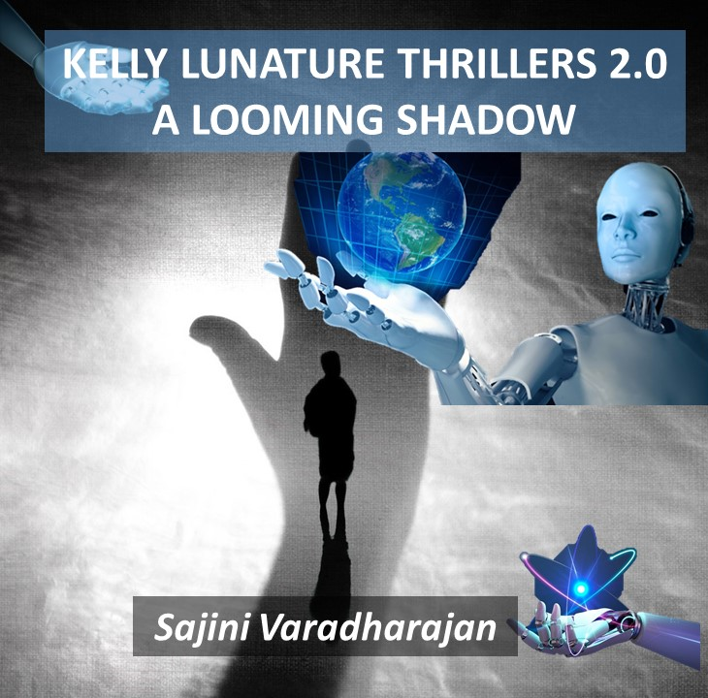

About Me..
All about me
Grade 8, Gems United Indian School, Abu Dhabi
Proud student of Clevered – AI Expert Level 1.
AIIP has given me an insight into Python Application.
A published author with 15 books on Amazon.
My 16th Book is all about AI – Kelly Lunature Thrillers 2.0: A Looming Shadow
12 years old
I expect to get my hands on AI through this internship.

Slide 5
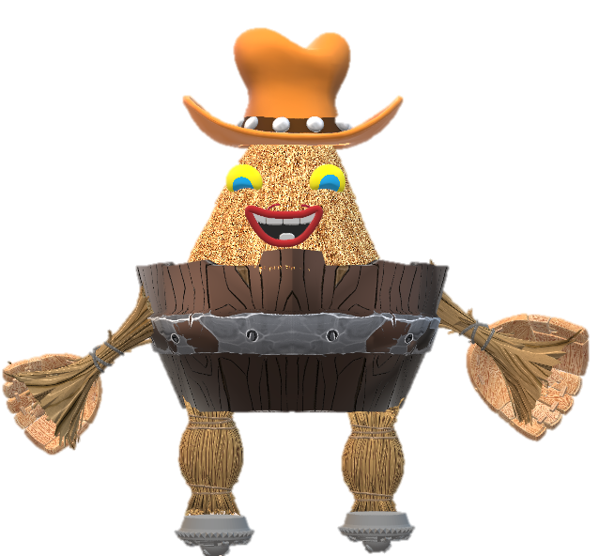

About My Internship Journey with Clevered..
I have received Rockstar Badges for Attentiveness, Timely Submission of Home Assignments, Wonderful Efforts for Project Completion and Timely Submission of App Development Toolkit (Part 1).
S is for Selfless, placing others before self
H is for Heroic, noble and self-sacrificing
I is for Influential, your opinion counts
V is for Versed, so knowledgeable
A is for Articulate, the gift of expression
N is for Nice, a sweet soul
I is for Illuminating, a fountain of knowledge
I was able to explore the World of AI with hands-on-learning experience every week.
An opportunity to intern under Mr. Ken,
I’ve got, so far, one of the best,
I’ll explore the world of Artificial Intelligence,
Under his valuable guidance crest!
S is for Skillful, ever up to the task
M is for Magnificent, a wonderful mentor
I is for Inspirational, the ability to motivate
T is for Thoughtful, considerate towards all
A is for Amiable, so pleasant to be with

Slide 6
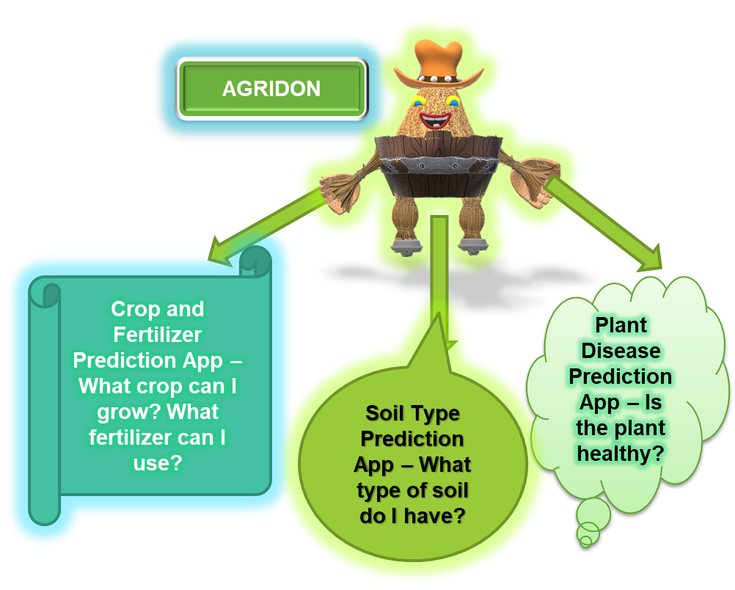
About Agridon…
My project covers three of the most important aspects of agricultural science, Plant Disease Prediction, Crop and Fertilizer Prediction and Soil Type Prediction.
The Plant Disease Prediction App will tell the farmer whether his or her plant is healthy. The Crop and Fertilizer Prediction App will enhance the farmer’s knowledge on the crop that can be grown in different qualities of soil and fertilizers that can be used to ensure a quality crop. The Soil Type Prediction App will tell the farmer what type of soil he/she has.
Finally, the AI I learnt till today will become the shining rays of sunlight for my model.
Going Green with Sustainable Agriculture and using Eco-Friendly Practices is the need of the hour. Sustainable agricultural practices are intended to protect the environment, expand the Earth’s natural resource base and maintain and improve soil fertility.
Economic stability and crop yield can be improved using my project too. To meet the growing needs of the human population, maximizing a good quality crop yield is one of the top priorities of agriculture.

Slide 7
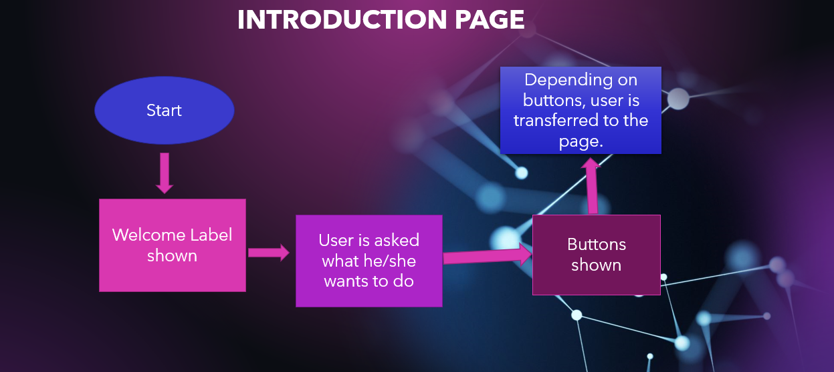
How do I use the App?
Once a button is clicked, the user goes to either Crop and Fertilizer Prediction, Plant Disease Prediction or Soil Type Prediction.

Slide 8
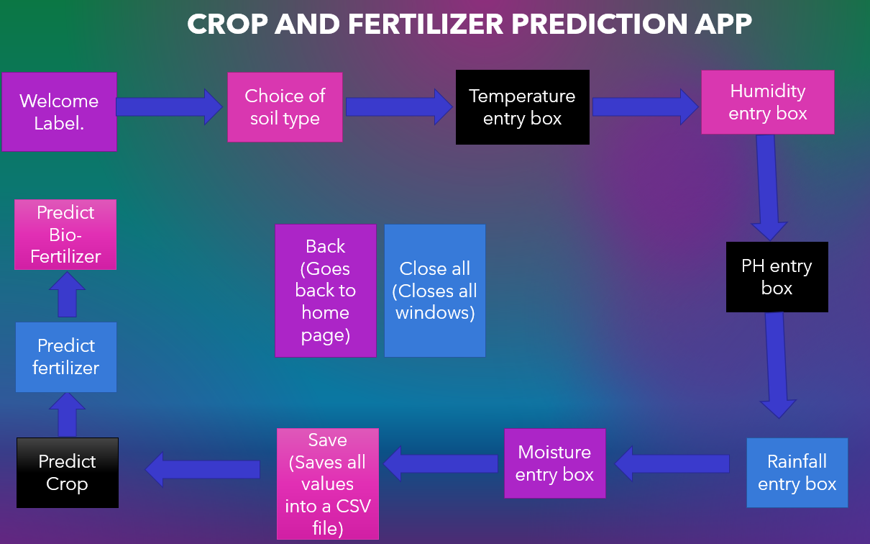
How do I use the App?
Based on all the values the user enters, the crop, fertilizer and bio-fertilizer is predicted.
A back and a close all button is placed in the app for sliding between screens or closing them.

Slide 9
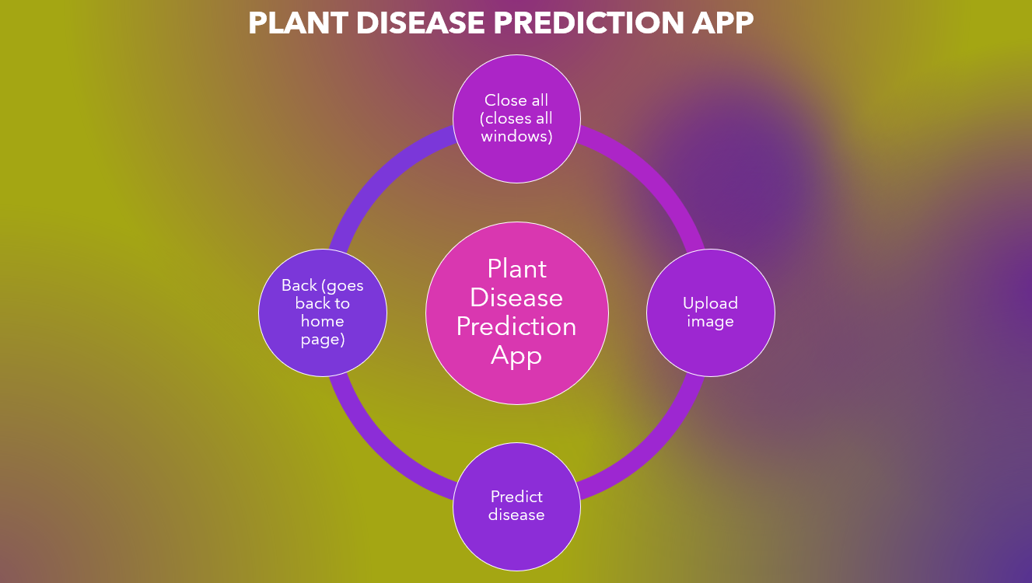
How do I use the App?
Here, a CNN model is trained to upload and predict plant disease. The farmer can ensure economic stability with this part of the Agridon.

Slide 10
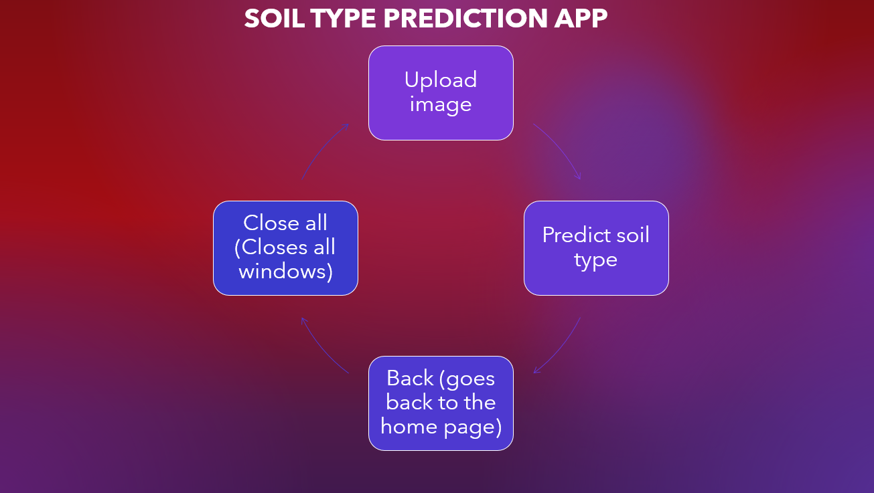
How do I use the App?
A CNN Model has been trained to predict soil type based on a picture. The farmer can analyze his/her soil type for better crop production and management.

Slide 11
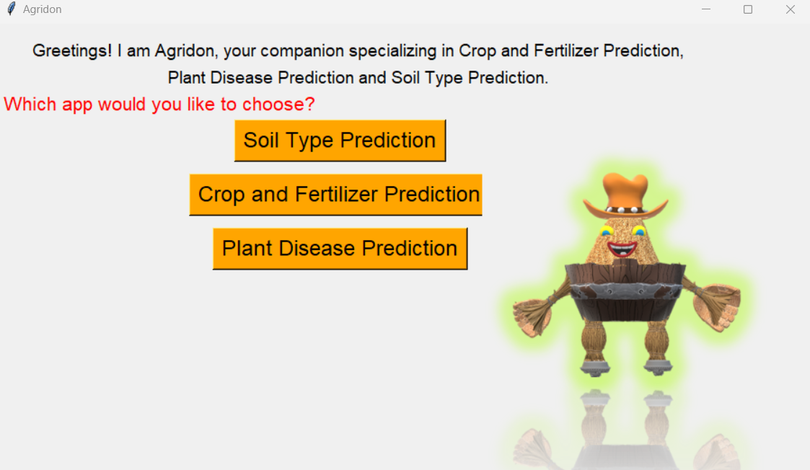
Introduction Page
The user can click on a button to go to the page he/she requires.

Slide 12
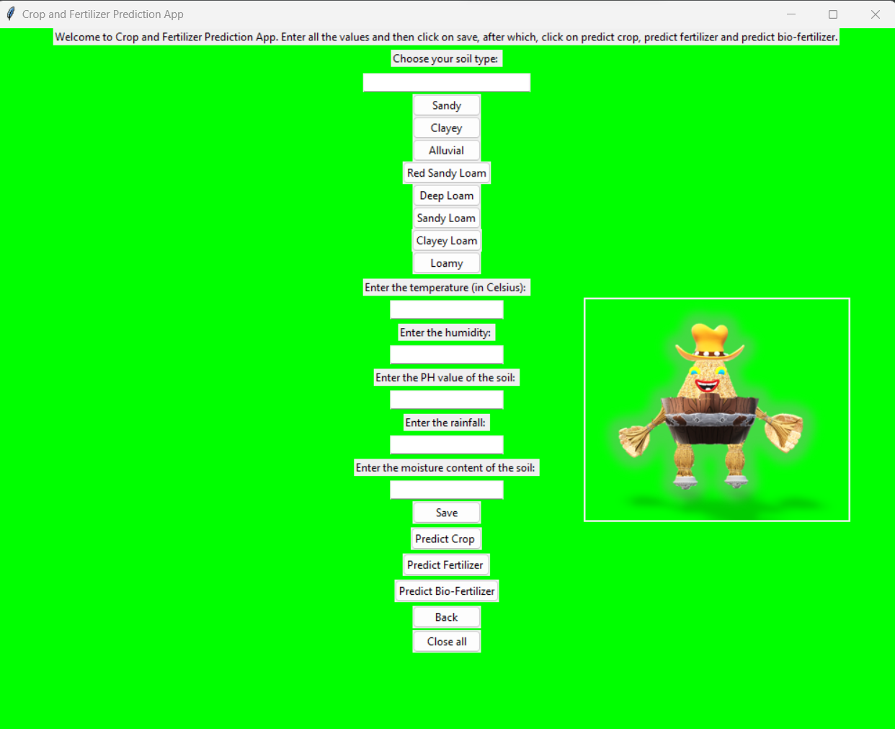
Crop and Fertilizer Prediction App
The user is required to enter all the values to predict crop, fertilizer and bio-fertilizer.

Slide 13
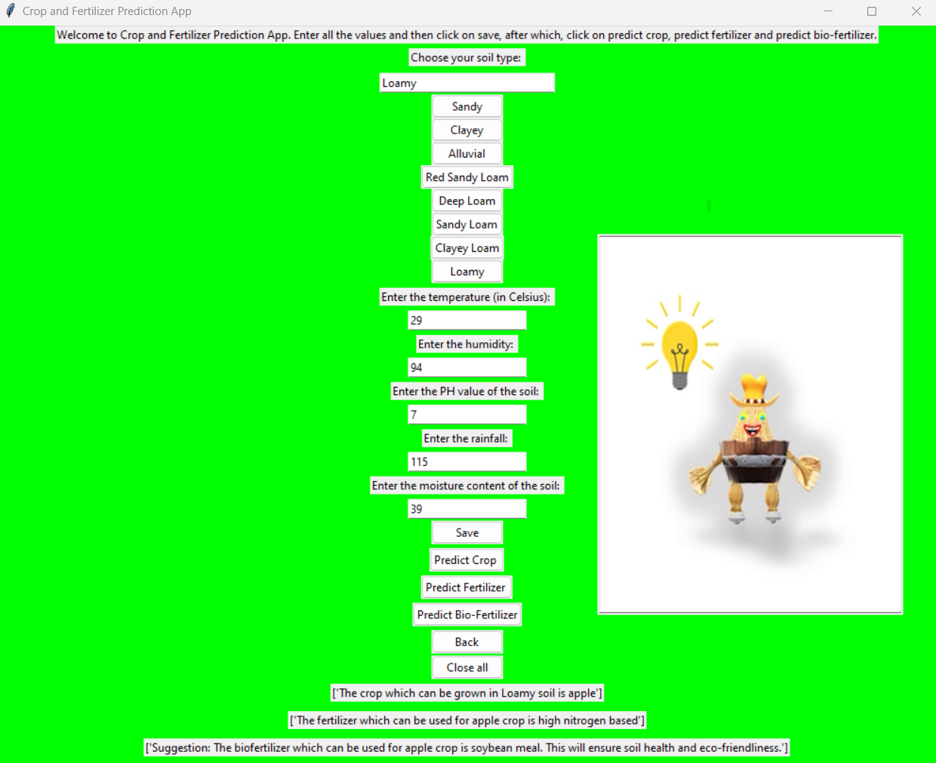
Crop and Fertilizer Prediction App - Output
The user is required to enter all the values to predict crop, fertilizer and bio-fertilizer.

Slide 14
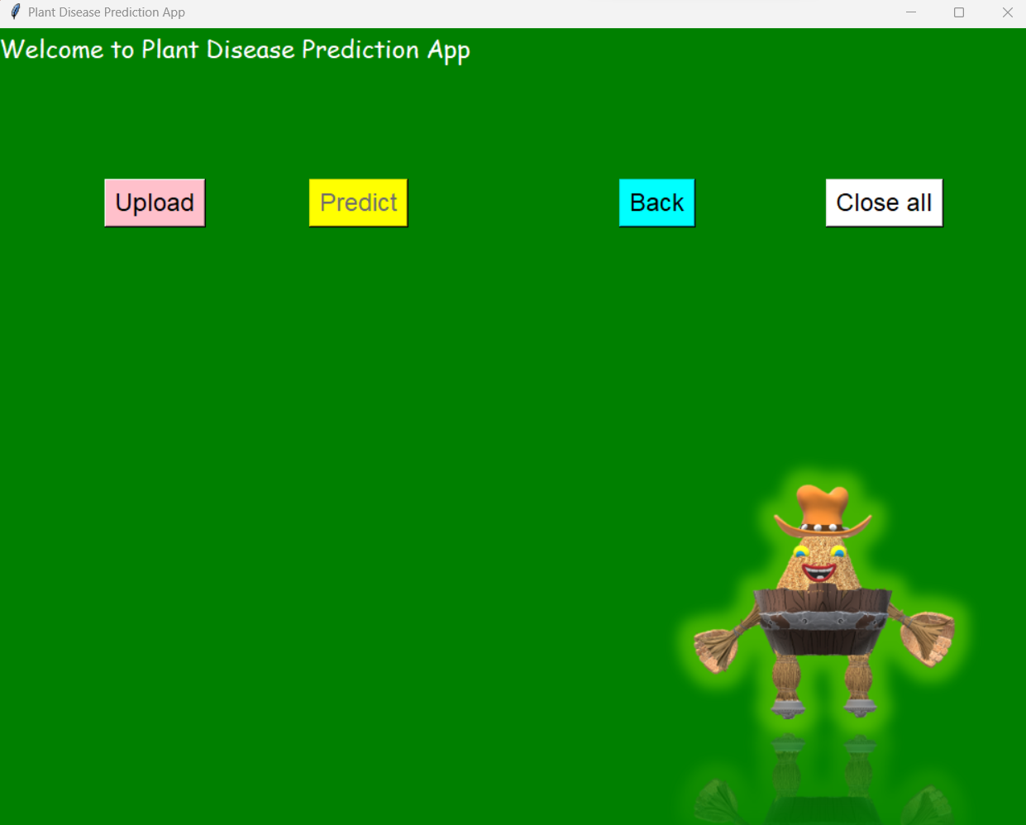
Plant Disease Prediction App
The user can upload an image and predict the plant health.

Slide 15
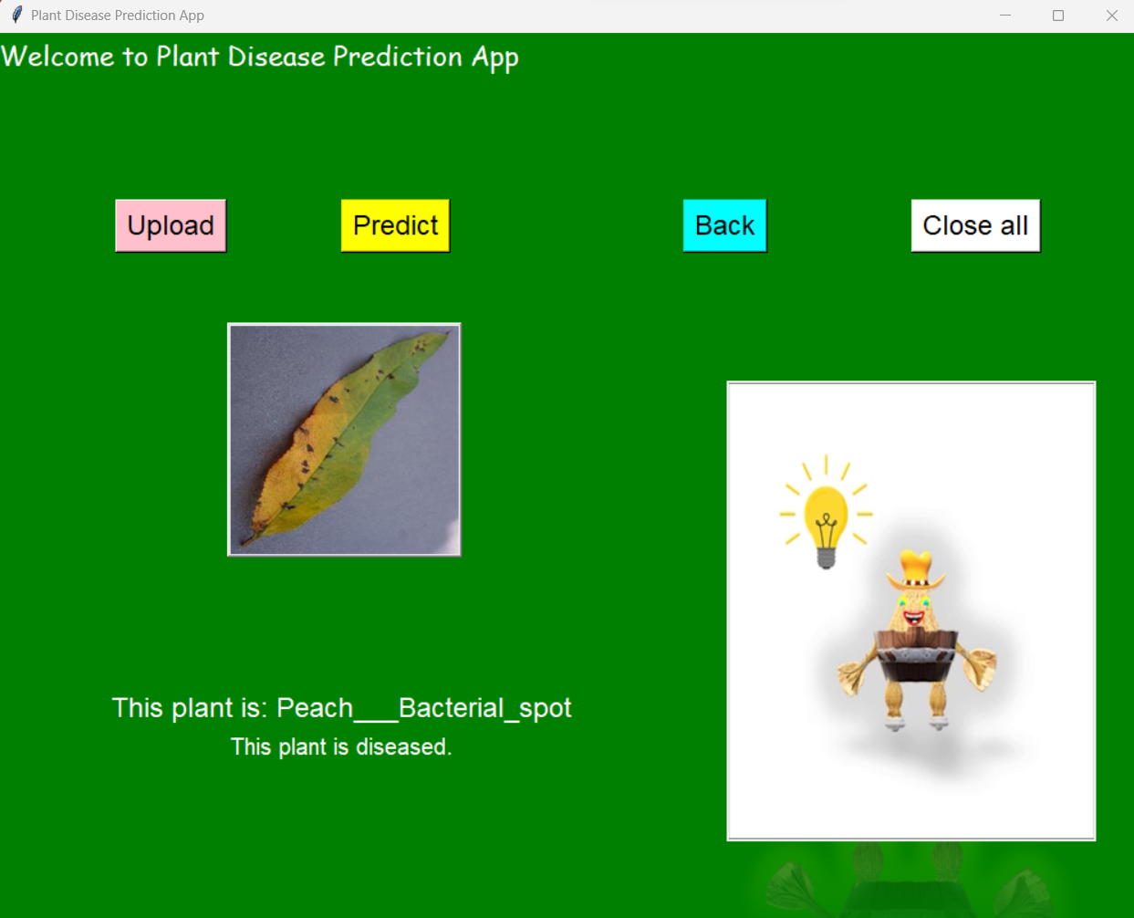
Plant Disease Prediction App - Output
The user can upload an image and predict the plant health.

Slide 16
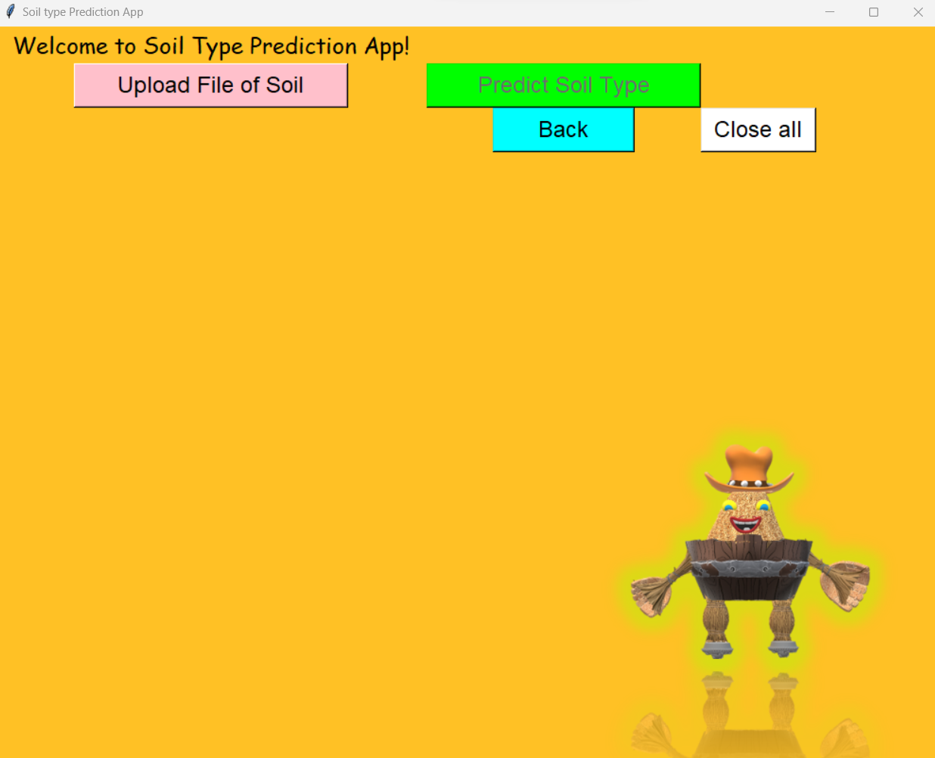
Soil Type Prediction App
The user can upload an image to predict the soil type.

Slide 17
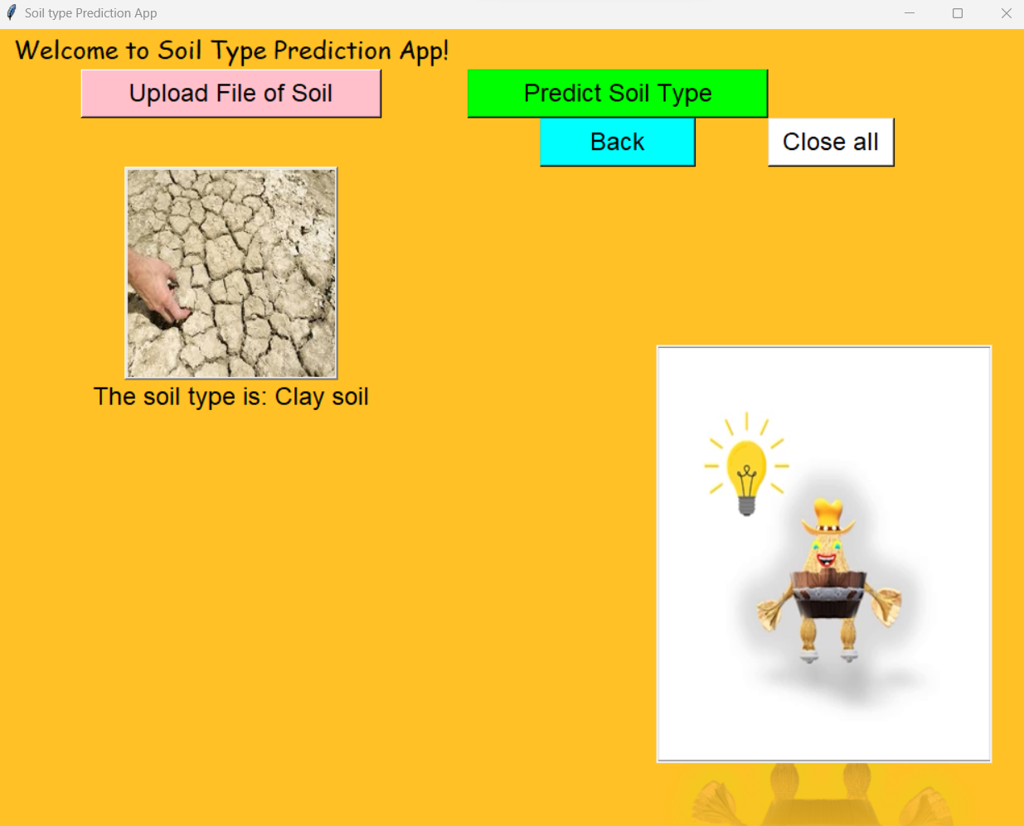
Soil Type Prediction App - Output
The user can upload an image to predict the soil type.

Slide 18

Contact Person
You can reach out to me on radhika_v84@yahoo.com.

Slide 19


